Slide 1
Robot Guide Dog
Yuting, Kenyan, Eric, Zihui

Slide 2
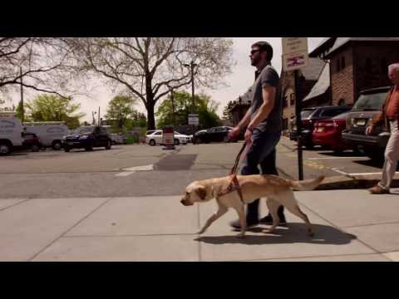
Guide Dog
First introduced in Germany
Bring to the US in 1927
4-6 months of training

Slide 3
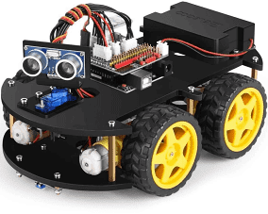
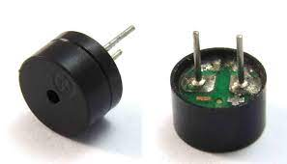
Our Robot Guide Dog
Computer

Slide 4
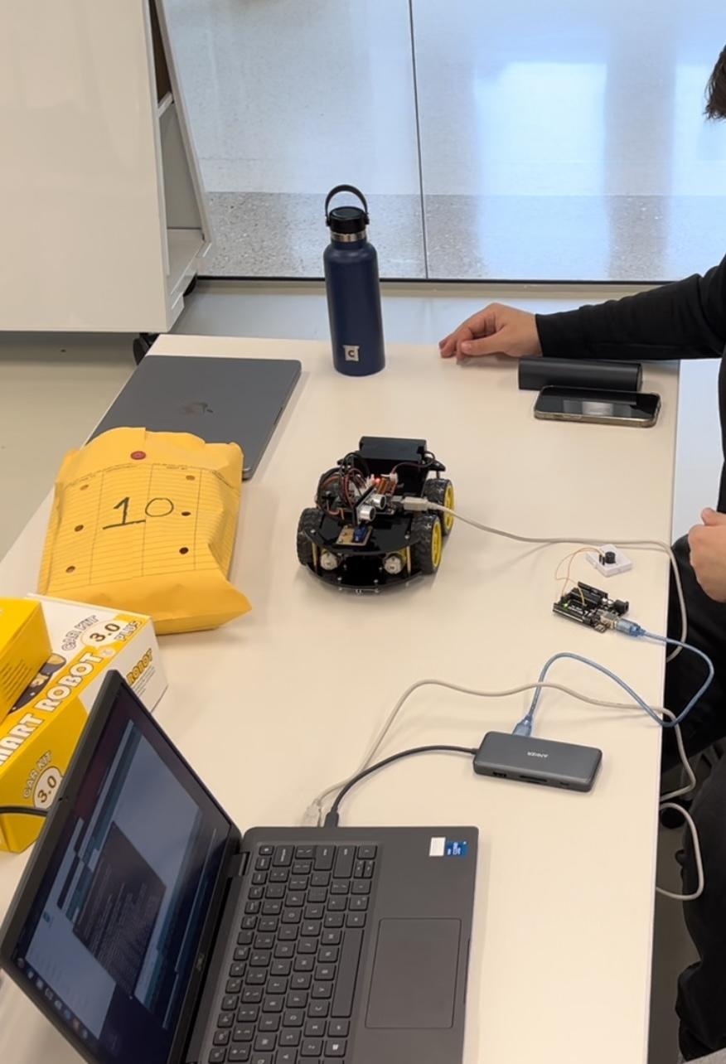
Our Robot Guide Dog

Slide 5


Slide 6
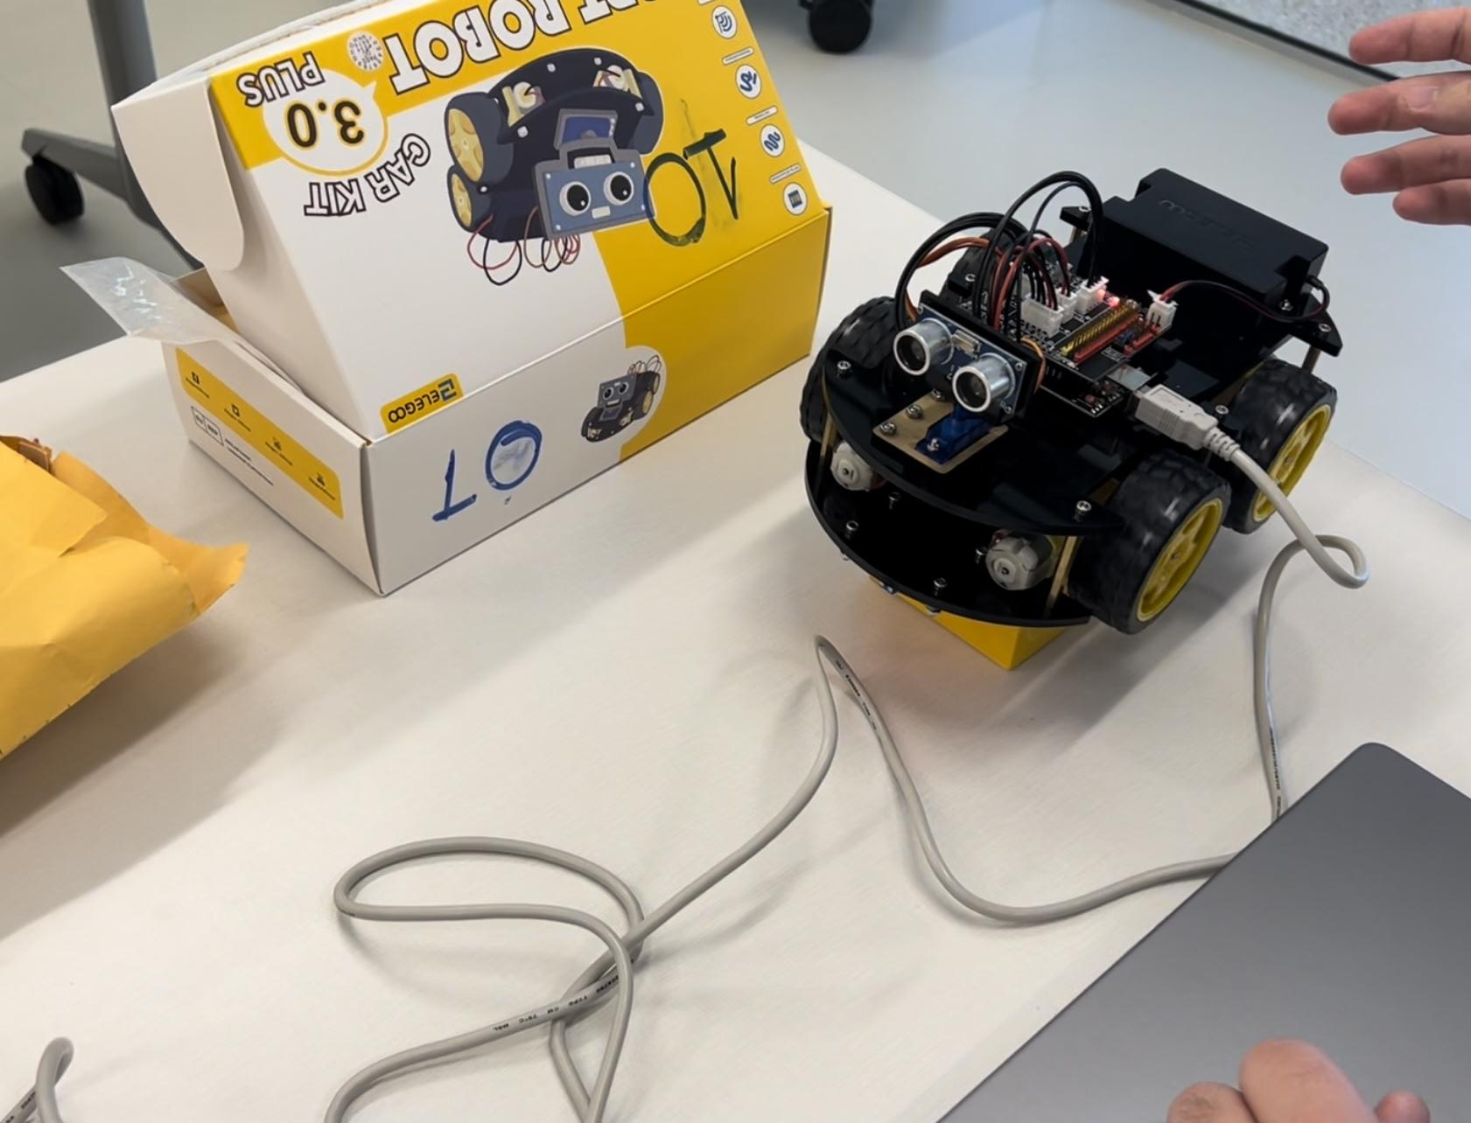
Publisher
Obstacle avoidance
servo
getdistance()
chassisMove()
Delays
‘int_msg’
code 0: front
code 1: left
code 2: right
code 3*: nothing

Slide 7
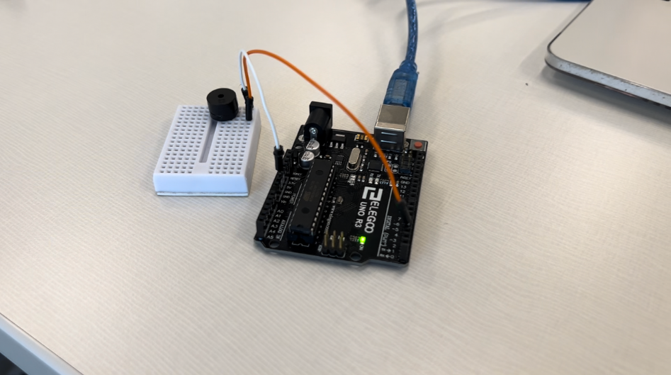
Subscriber
Subscriber Callback
tone()
notone()
‘int_msg’
code 0: Note C5
code 1: Note A6
code 2: Note D6
code 3*: Note G5

Slide 8
Improvements
Replace notes with recorded voice to provide better instructions
Replace ultrasonic sensor with camera to get better obstacle detection
Voice Control
voice recall

